Slide 1
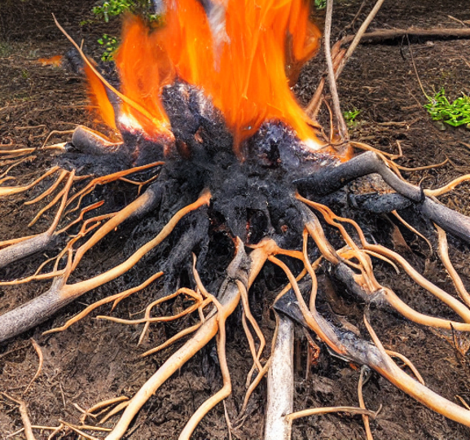
The impact of fire frequency on the root economic spectrum in herbaceous plant species from Cedar Creek Ecosystem Science Reserve

Slide 2
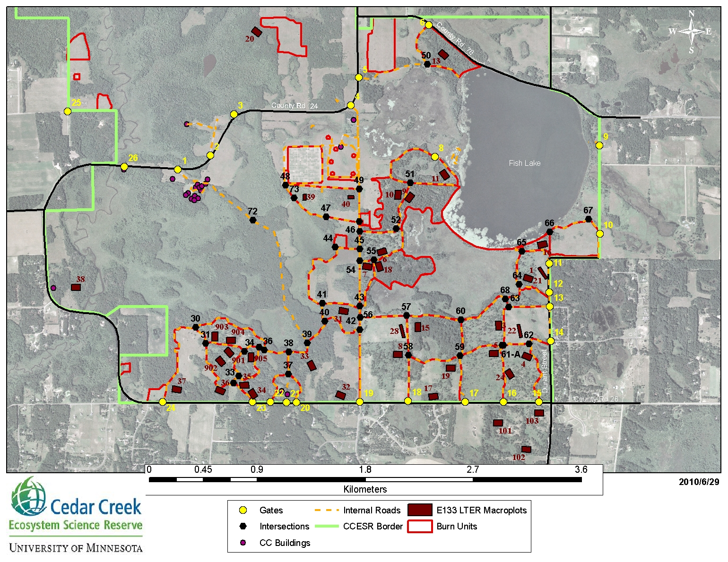
Background on the project
Understanding how plant species and communities optimise trade offs after disturbance events, belowground Cedar Creek Ecosystem Science Reserve - plots with different prescribed burn frequencies. How does fire frequency affect mycorrhizal colonisation in herbaceous plants?

Slide 3
Hypotheses

Slide 4
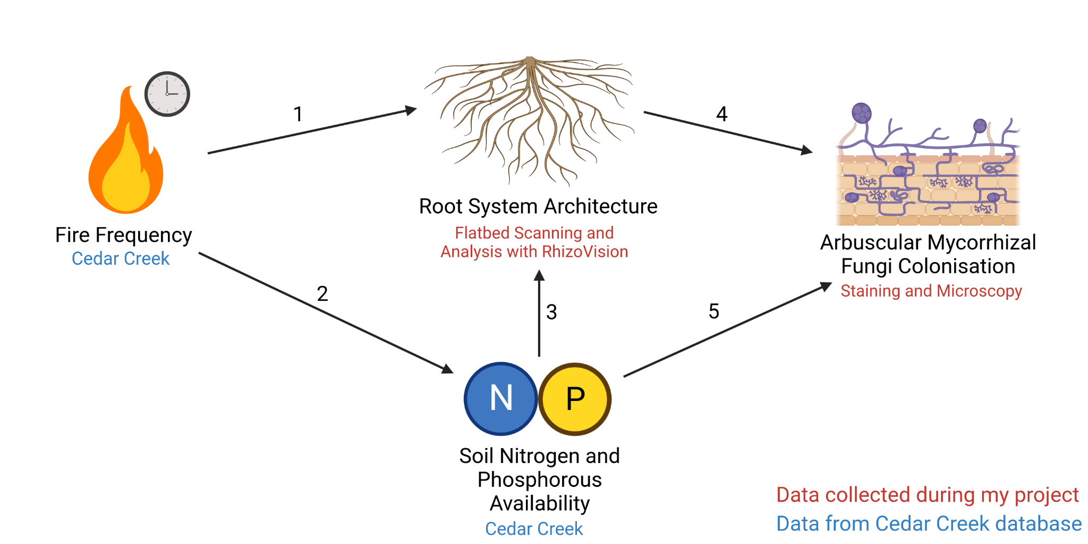
Graphical Abstract

Slide 5
Methods - Overview

Slide 6
Methods - Quantifying mycorrhizal colonisation

Slide 7
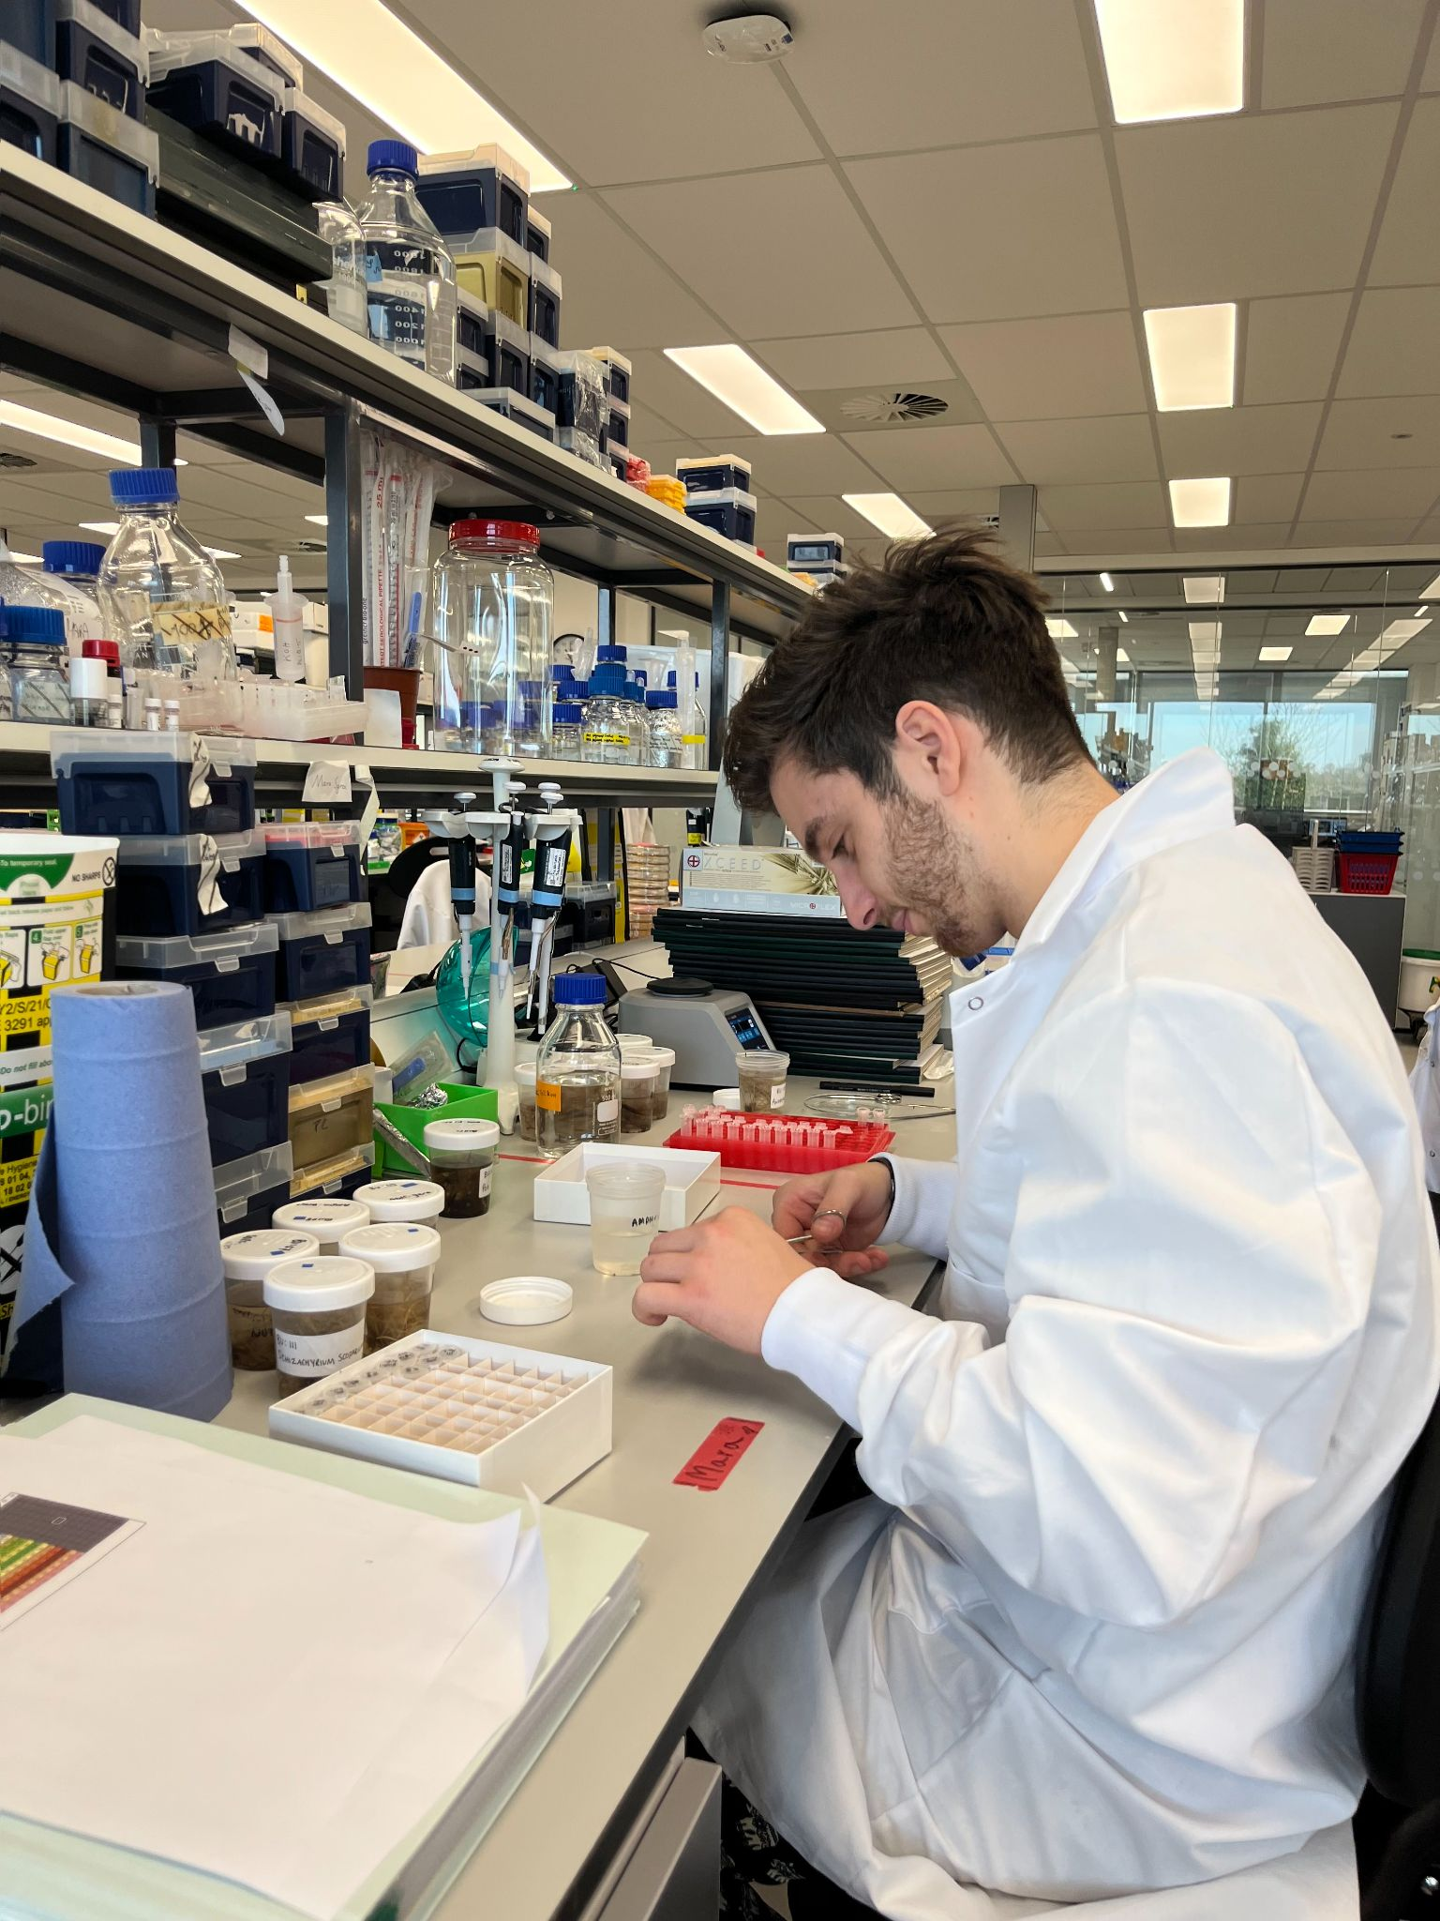
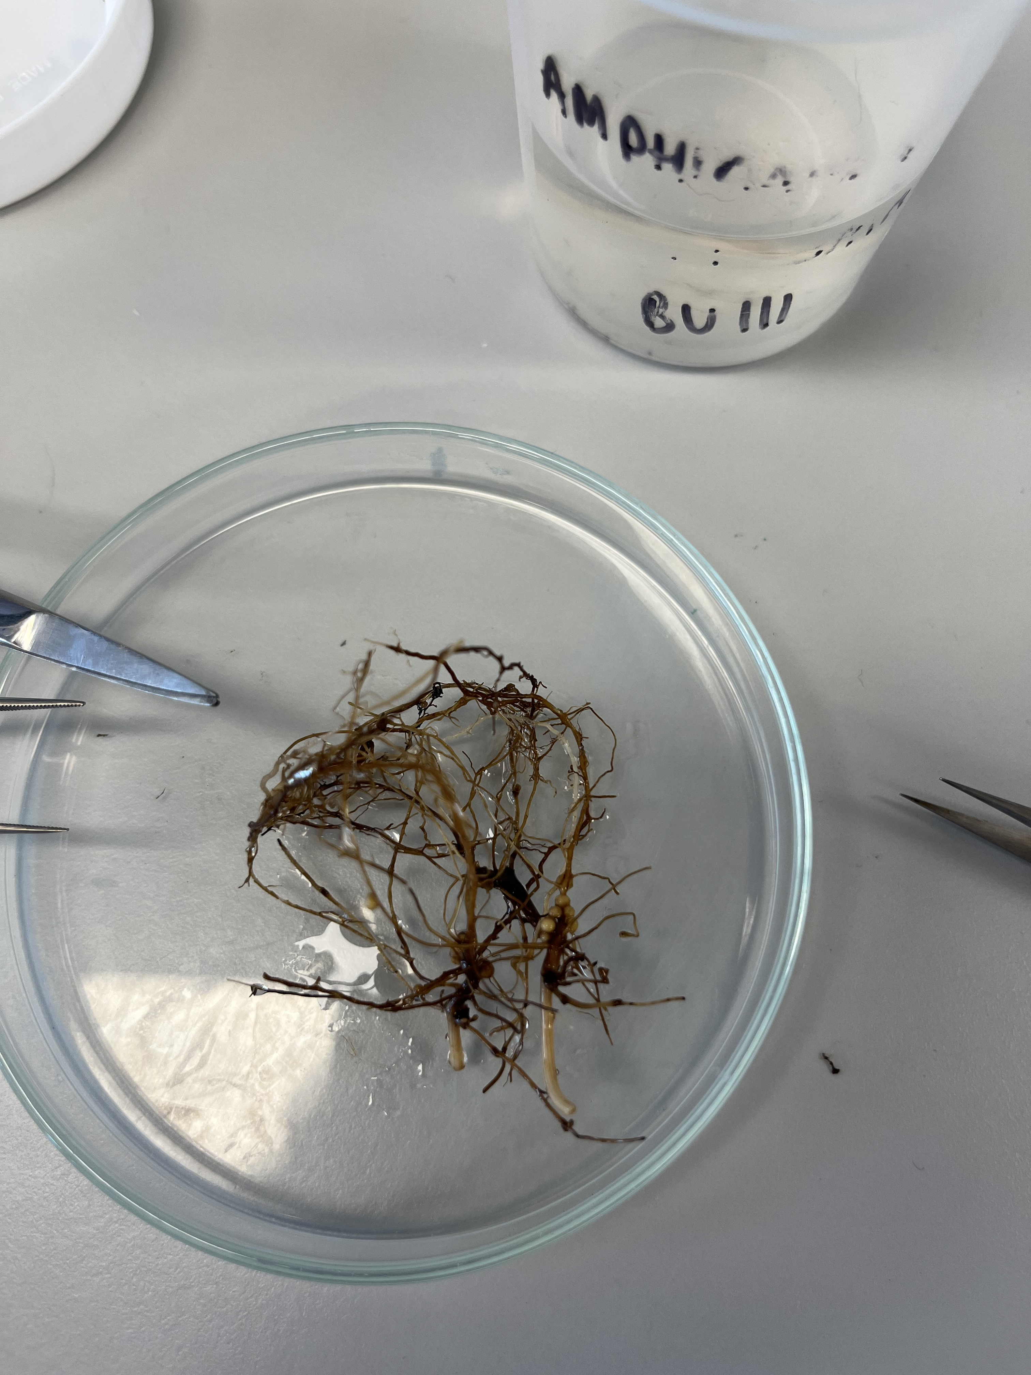
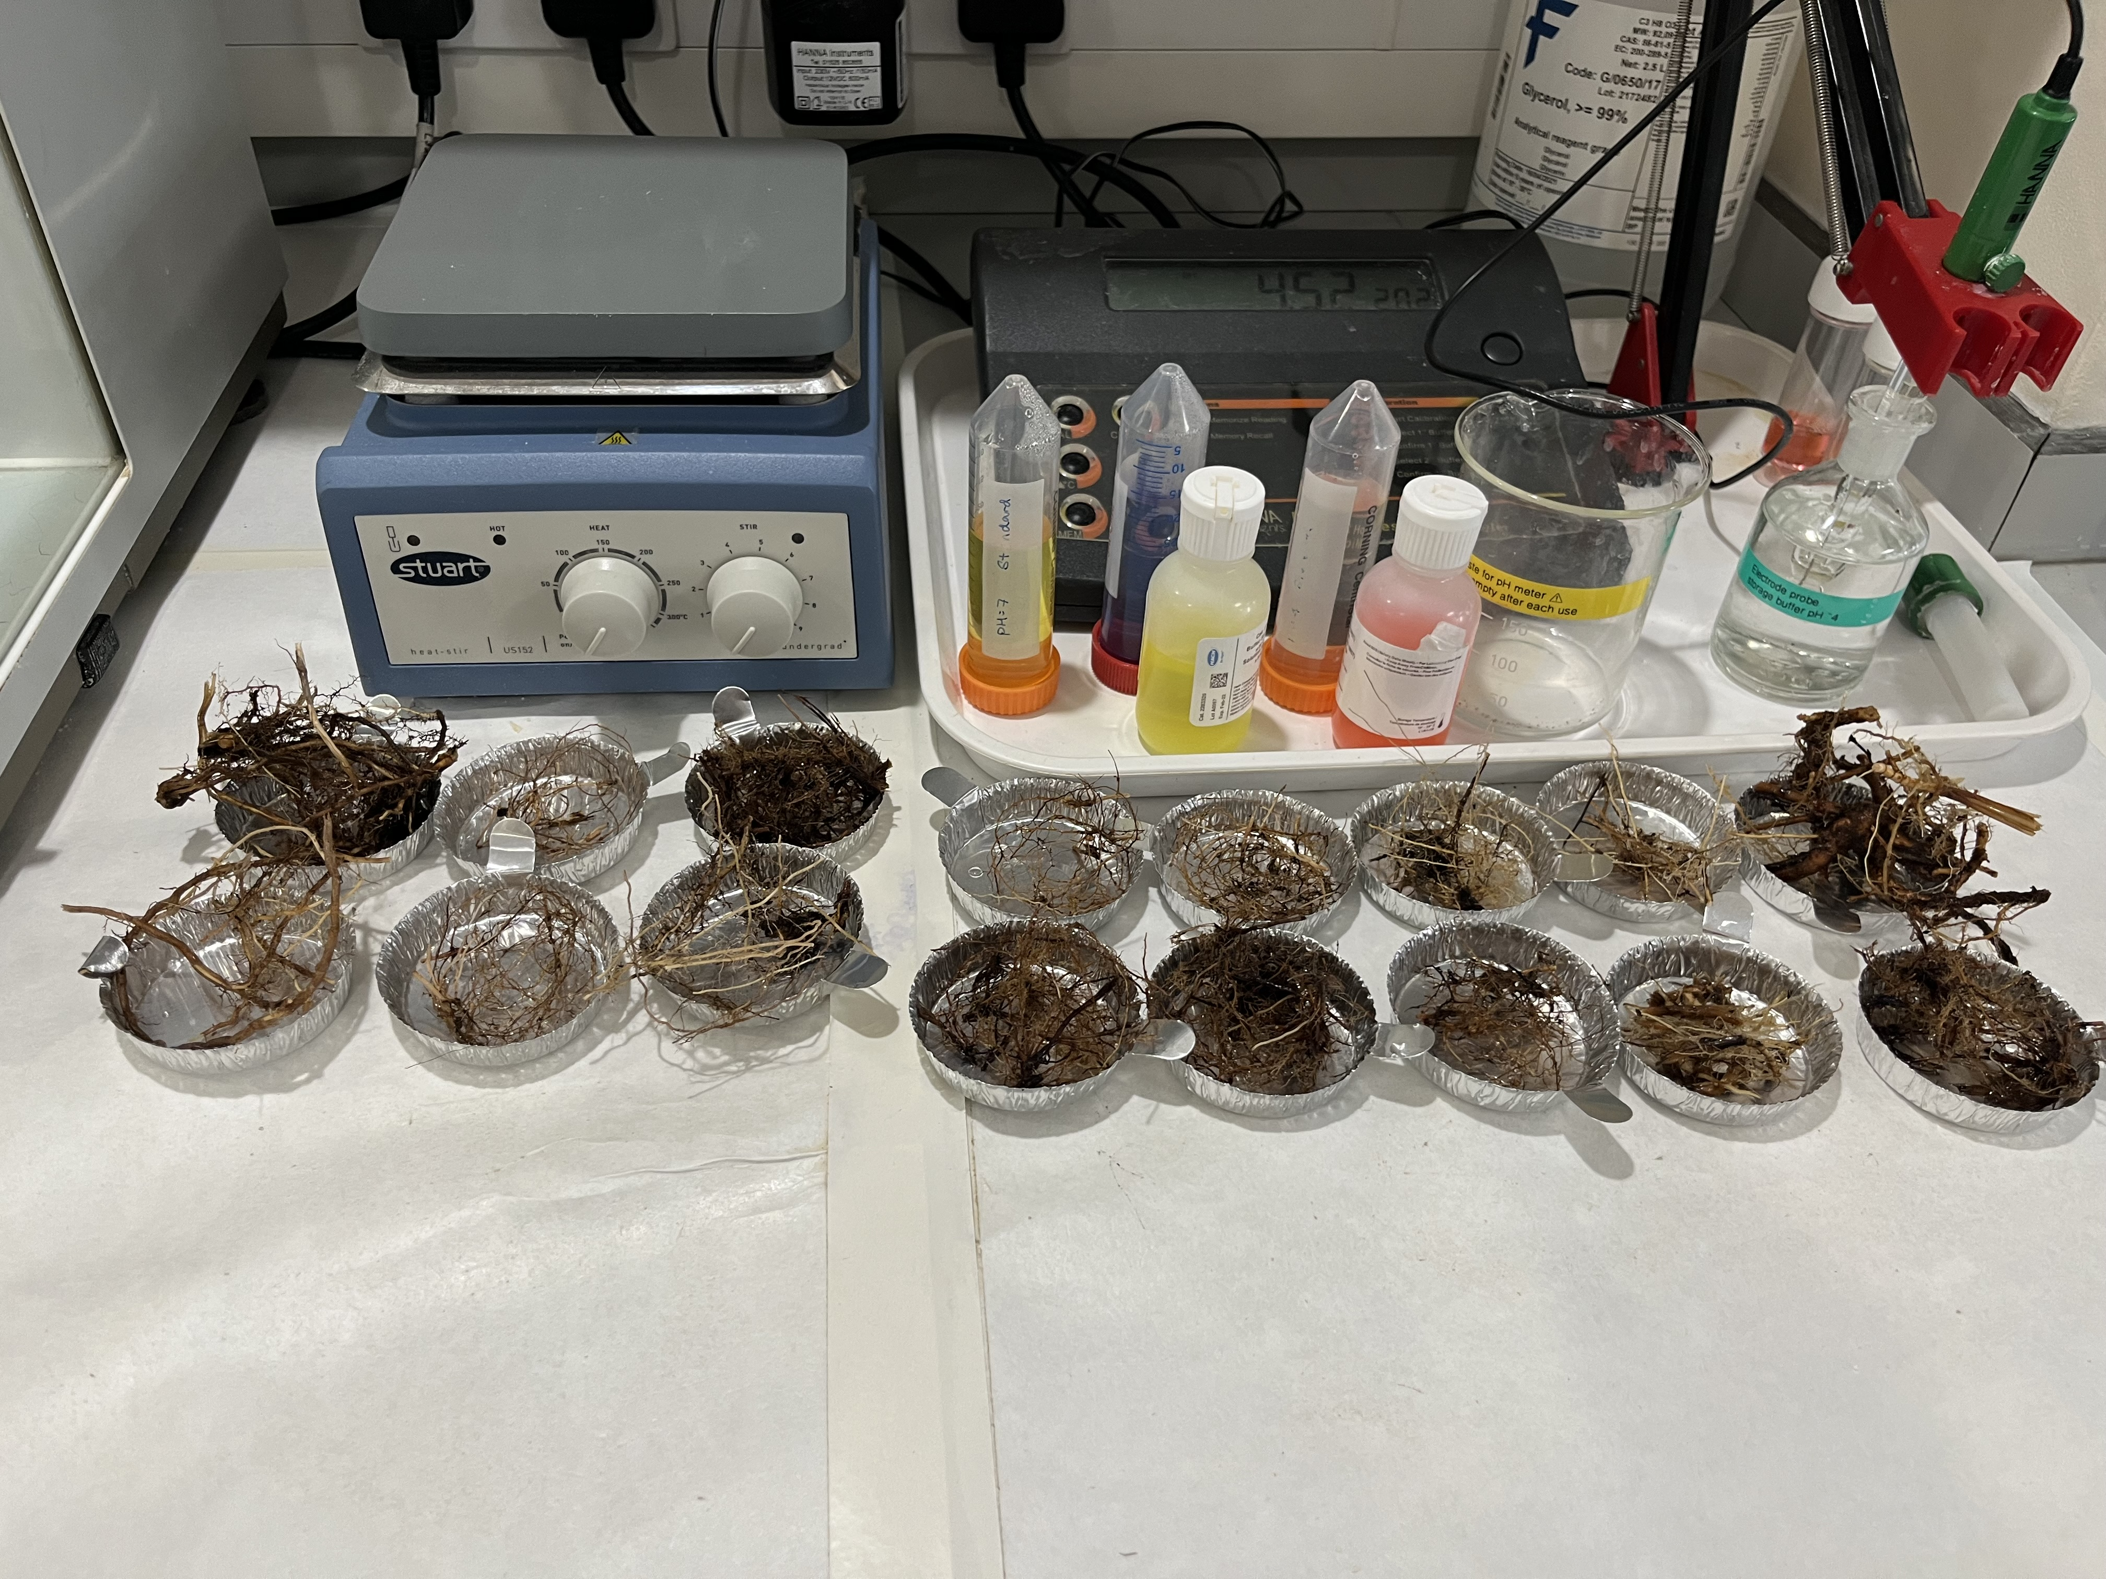
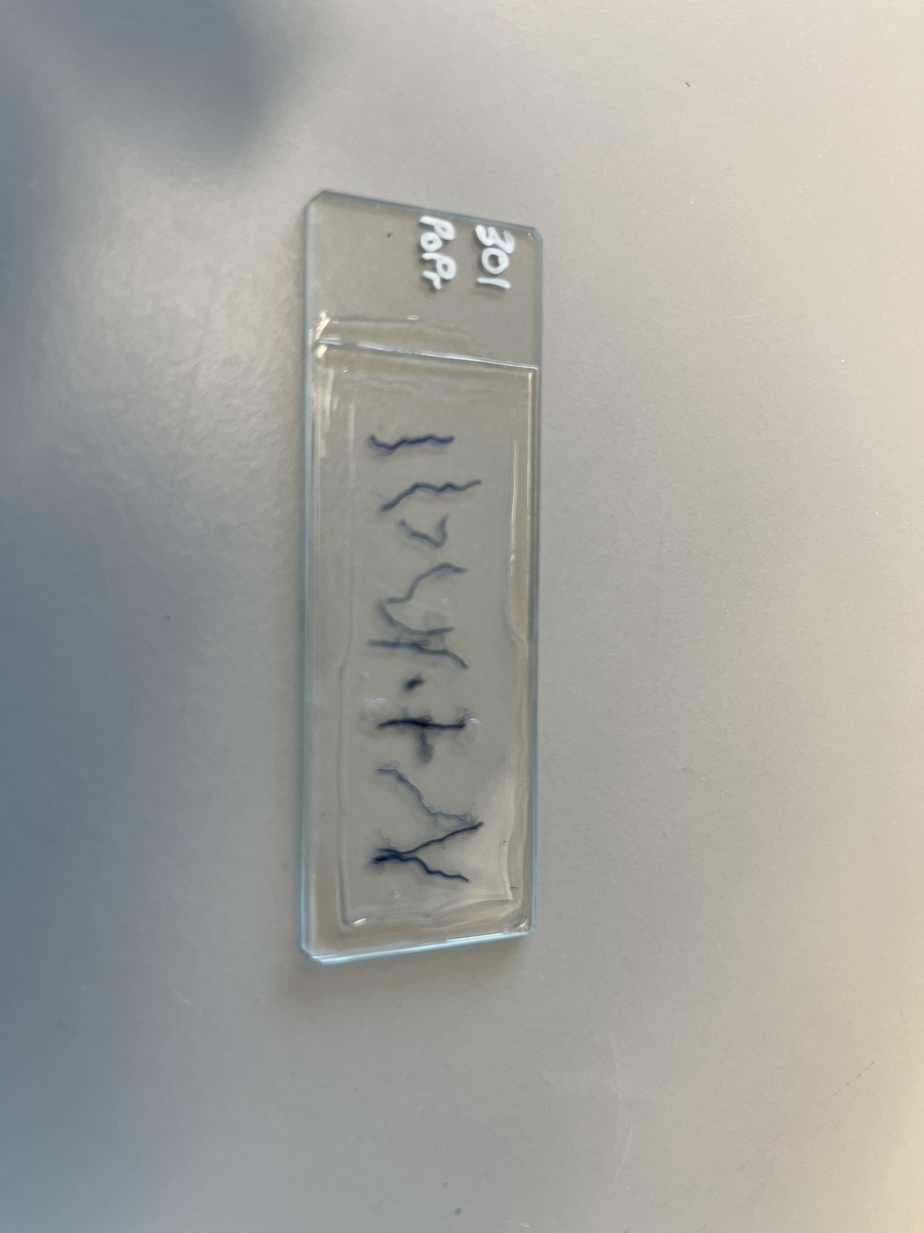
Day in the Life

Slide 8
Methods – Soil nutrient data

Slide 9
Methods – Root Architecture Data

Slide 10
Methodological challenges – quantifying mycorrhizal colonisation

Slide 11
Staining

Slide 12
Identifying arbuscular mycorrhizal (or pathogenic) fungal structures

Slide 13
Strange root structures

Slide 14
When we got a bit too excited…

Slide 15
A diverse range of AMF structures

Slide 16
Results - Overview

Slide 17
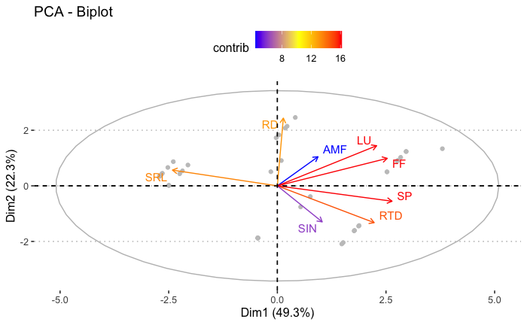
Results -
mycorrhizal colonisation and average root diameter, as well as soil inorganic nitrogen don't contribute to the variance in the data

Slide 18
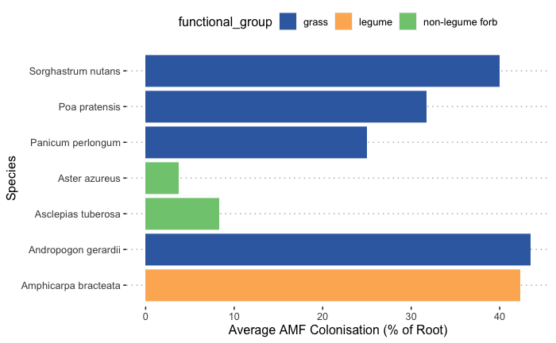
Non-legume forbs seem to be colonized less (though may be because under sampled)

Slide 19
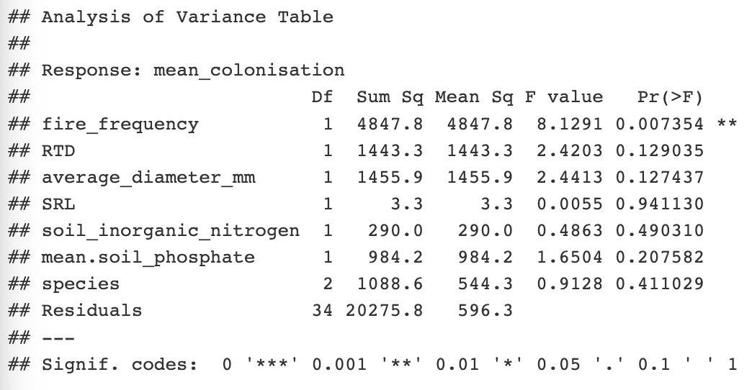
Results – Fire Frequency is the only predictor of mycorrhizal colonisation, though this may be due to methodological limitations

Slide 20
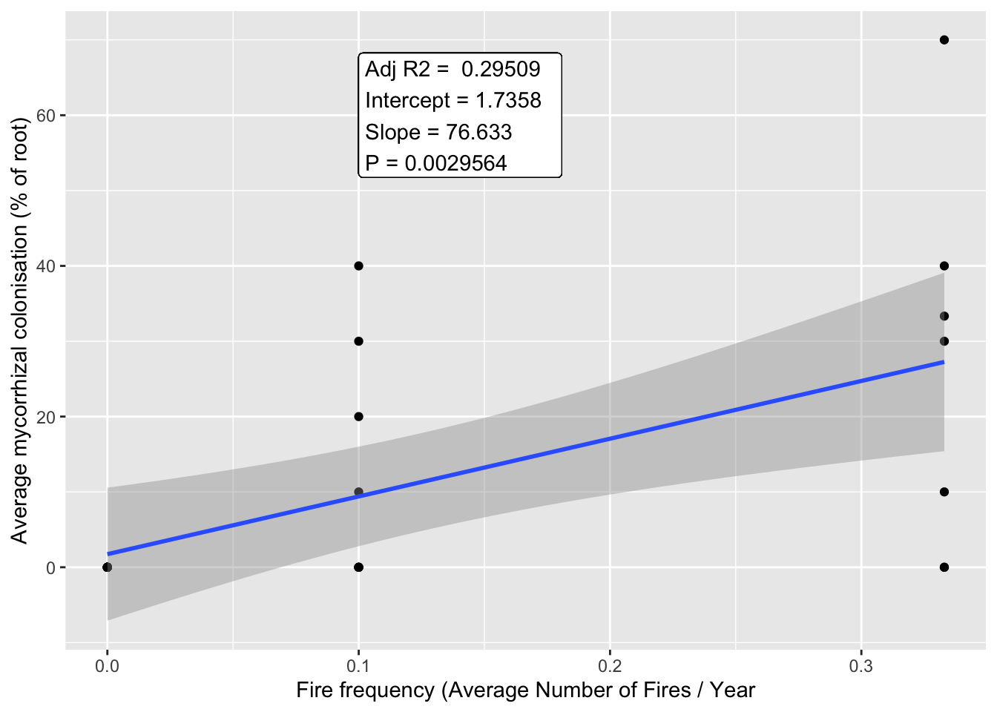
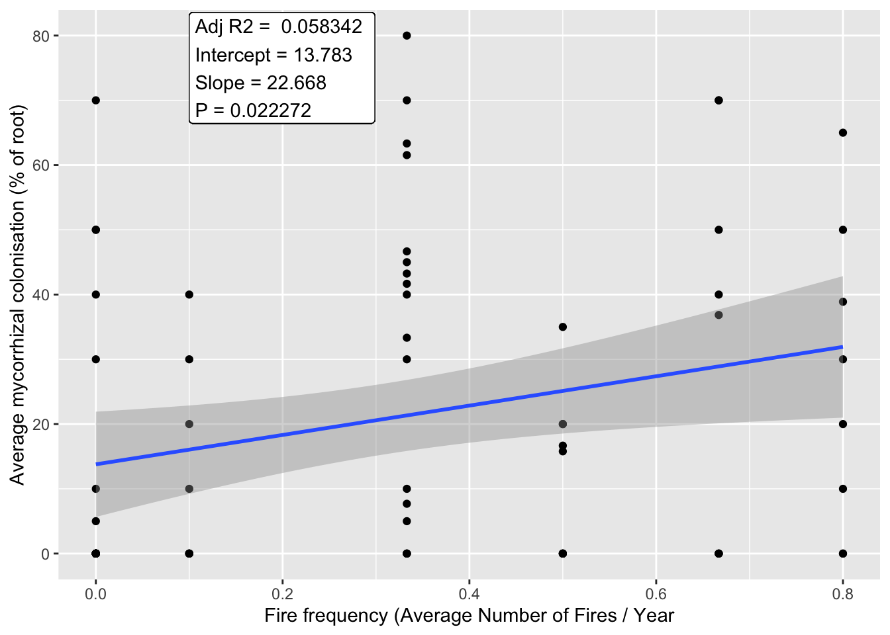
Each species had a different response to increasing fire frequency, but significant correlations were positive

Slide 21
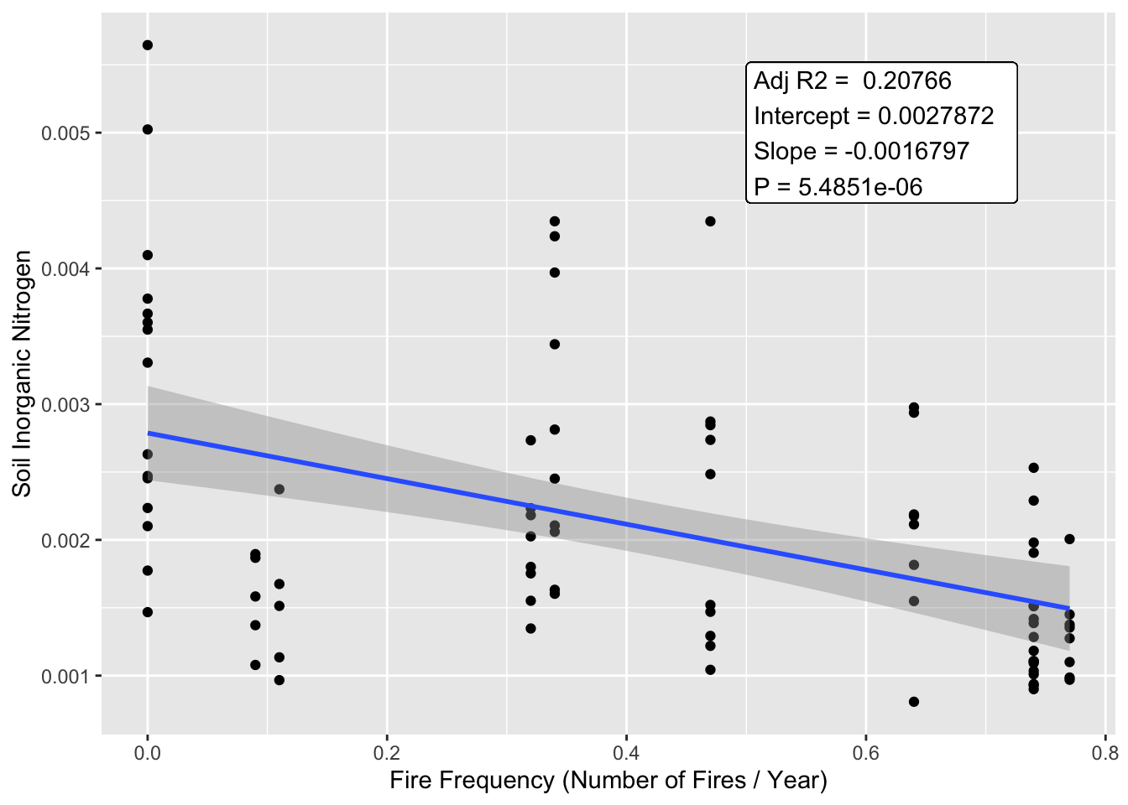
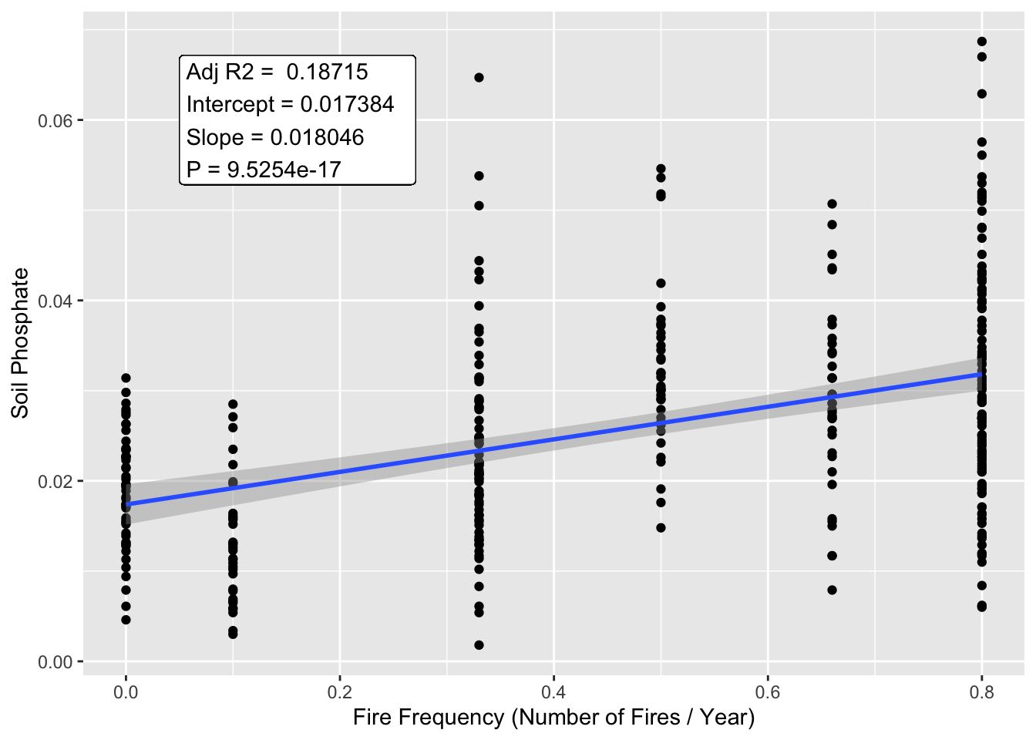
Fire frequency is associated with decreased nitrogen, but increased phosphate

